Slide 1
Inoculation Theory and Message Sensation Value

Slide 2
Inoculation and Message Sidedness

Slide 3

Should I tell them what the other side will say?
Message Sidedness refers to the position being presented in a message.
One-sided messages may simply ignore opposing arguments.
The goal is to convince people that a problem exists and present a solution.
Two-sided messages present arguments from both points of view.
A “refutational two-sided message” is the most effective.
It presents the “other side” of the argument but concludes that the persuader’s view is more desirable.

Slide 4
One-sided messages are more effective when:
The audience is in general agreement with the position advocated.
The desired outcome is to reinforce existing attitudes or increase the commitment of the audience.
The audience is not likely to encounter messages that contradict the position being advocated.

Slide 5

Who responds best to two-sided (refutational) messages?
People with more formal education (at least a high school degree).
People who will be exposed to opposing arguments in the future.
People who already have been exposed to opposing arguments.
Before accepting persuader’s opinion, opposing arguments must be refuted or shown to be unimportant.
Failure to acknowledge opposing arguments may raise questions of source competence or trustworthiness.
Support for PBS

Slide 6

Message sidedness and Truisms
What’s a cultural truism?
Effect on cultural truisms
Refutational treatments most effective
Effect on non-truisms
Supportive and refutational treatments were about equal in effect

Slide 7

How can I get people to resist being persuaded by the other side?
Inoculation theory uses a biological metaphor:
Give people a weakened “dose” of what the other side will say.
Cannot provide “full strength” argument.
Like a vaccination, this creates resistance.
Supportive strategy
Provide people with reasons to continue believing what they already do.
The greatest resistance is seen when both strategies are used together AND there is a bit of a time delay so people can form their own counterarguments.

Slide 8
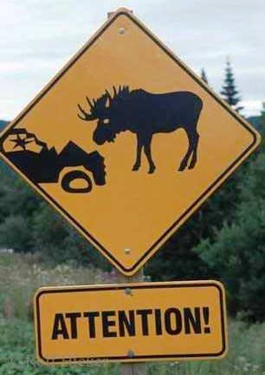
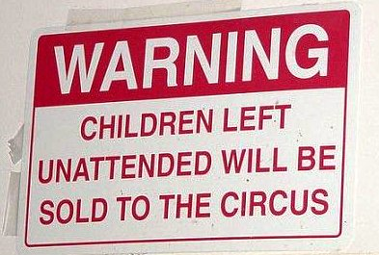
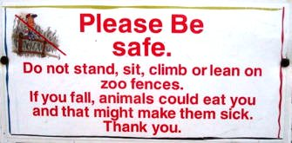
Warnings
Forewarning people they are going to be persuaded will also make them more resistant.
There are two types of forewarnings:
Persuasive intent
Specific topic and position
Forewarnings that an audience’s attitudes will be attacked seem to irritate and even anger people, which helps resistance further.

Slide 9
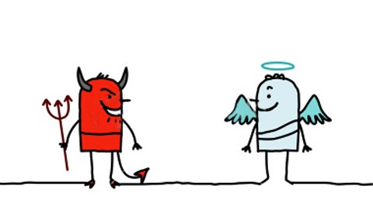
Reframing Effects
Politicians are masters of reframing through the careful use of language.
“God Terms”
What we value most in our culture: family values, balanced budget, personal responsibility
“Devil Terms”
What we fear most in our culture: Communism, Nazis, terrorists
“Charismatic Terms”
Abstract terms that have a magical aura: Freedom, democracy

Slide 10

Reframing, continued
Some examples of highly effective reframing using language:
Estate tax → “Death tax”
Tax cuts → “Tax relief”
Global warming → “Climate change”
Frank Luntz 1
http://www.youtube.com/watch?v=4Yz8UwRsWPA
Frank Luntz 2
http://www.youtube.com/watch?v=6U4TLZRK2Ek
Words that start with “r” or end with “-ity” are good. “Prosperity,” “reform,” “accountability,” “responsibility” are examples.
Clip: Toxic Sludge, Chapter 8 (genetically modified foods)

Slide 11
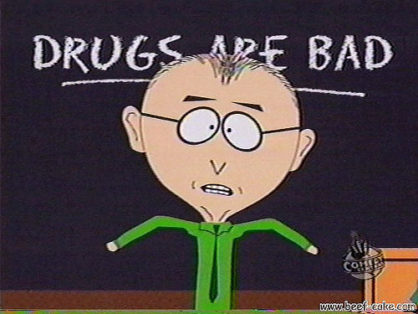
Message Sensation Value
Communication can be used in other ways to create more powerful messages.
Which anti-drug PSAs (public service announcements) do you recall seeing on television?
The messages you think are effective are (in part) linked to your level of sensation seeking.

Slide 12
How high is your level of sensation seeking? Answer Yes or No to each of the following questions:
1. I like to have new and exciting experiences and sensations even if they are a little frightening.
2. I like doing things just for the thrill of it.
3. I sometimes do "crazy" things just for fun.
4. I sometimes like to do things that are a little frightening.
5. I enjoy getting into new situations where you can't predict how things will turn out.
6. I'll try anything once.
7. I prefer friends who are excitingly unpredictable.
8. I like "wild" uninhibited parties.
9. I would like the kind of life where one is on the move and traveling a lot, with lots of change and excitement.
10. I am an impulsive person.
11. I like to explore a strange city or section of town by myself, even if it means getting lost.
12. I would like to take off on a trip with no preplanned or definite routes or timetables.
Add up the number of times you responded “yes” to the above questions. Divide by 12.
00 - 27% = Very Low 28 - 41% = Low 42 - 70% = Average 71 - 84% = High 85 - 100 = Very High

Slide 13
Audience-centered message design: Message Sensation Value
Problem: High sensation seekers are up to 10 times as likely to experiment with drugs.
A bigger problem: Most anti-drug PSAs suck.
The question: What makes some anti-drug PSAs better than others? Lab rat vs. Bush
The research:
Content analysis of 110 PSAs on all the dimensions that might make a difference
Experiment to test whether high MSV PSAs are more effective than low MSV PSAs

Slide 14
Dimension/Feature | Scoring | Description
Visual
Cuts | Count of cuts; also converted to low (0-6 cuts), moderate (7-14 cuts), and high (more than 15 cuts) levels | The number of times the camera cuts from one visual scene to the next. Includes the final cut to agency sponsor at the end of the PSA.
Special visual effect | 0/1 (absent/present) | Anything beyond the range of human ability and involves special visual effects, including morphing, paint or blood “sliding” down the screen, or computer manipulation of images.
Slow motion | 0/1 (absent/present) | The slowing of real-life action through technical intervention.
Unusual colors | 0/1 (absent/present) | Unusual colors outside the range of colors normally perceived in real life.
Intense images | 0/1 (absent/present) | Intense or horrifying images including needles going into arms, guns pointed at heads, or death.
Audio
Sound saturation | 0/1 (absent/present) | Background sound throughout the PSA, including street noise or other sounds, rather than simply having a person talking throughout the PSA.
Music | 0/1 (absent/present) | Background music in the PSA.
Sound effects | 0/1 (absent/present) | Unusual sounds (those which could not have occurred in “real life” in that situation) heard in the PSA, including gongs and other noises.
Content
Acted out (vs. talking head) | 0/1 (absent/present) | Instead of being told about the dangers of drugs (or the benefits of being drug-free), viewers view actions corresponding to point of the PSA.
Unexpected format | 0/1 (absent/present) | If images and message are interchangeable with other anti-drug PSAs, it is “expected.”
Surprise/Twist ending | 0/1 (absent/present) | The presence of a climactic, shocking end to the PSA. If the end cannot be predicted, it has a “second-half punch.”

Slide 15
A few PSAs
First group:
110: Alex/Straight A
45: April/Lost Mom
14: Duane/Never
Second group:
Housewife
1: Thin Ice
5: Everybody’s Doing It
7: Teeth

Slide 16
Results
People who are high in Sensation Seeking (HSS) responded most favorably to PSAs that were high in Message Sensation Value.
High MSV messages were those that had intense imagery, lots of sound, acted out consequences of drug use, and used an unexpected format to present the message.
It also appears that HSS people high in NFC may respond best to PSAs with a high cognitive value.
High cognitive value: Messages with arguments and substance.
Examples:
Taking Chances
Drink

